Slide 1
Education Funding Reform Study Committee
October 29, 2019
Historical and Current State Funding
Grant Gibson, SC Senate Finance Committee staff

Slide 2
Before Education Finance Act
1951 – SC adopts 3% retail sales tax for public education
1669 – SC increases sales tax from 3% to 4% for public education
1975 – SC enacts Act 208 to create uniform property classifications and equitable assessment rates
Nationally – School equity lawsuits in Texas, New Jersey, New York
1977 – Education Finance Act (EFA) enacted

Slide 3
Education Finance Act (EFA)
Act 163 of 1977
Legislative Intent
  To guarantee each student in SC the availability of at least minimum educational programs and services
  To establish a procedure for distribution
  To make it possible to offer the minimum program with an equal local tax effort – not equal dollars
  To establish a reasonable balance between state and local portions
  To require each district to contribute its fair share

Slide 4
What is the EFA
Foundation program for district and school operations
Formula distributes state funds based on local property wealth and weighted pupil units
70% of the statewide cost of the foundation paid by the State
30% paid collectively by local school districts
Individual school district percentages vary based upon local property tax wealth (Index of Taxpaying Ability) and weighted pupil units
Today, percentage of state support for individual school districts varies between 24% and 93%

Slide 5
EFA Foundation Program in Law
Includes
Defined Minimum Program
Base Student Cost
Weightings
Excludes
Transportation
Capital Outlay
Pilot Programs
Adult Education
Textbooks
Food Service
Employee Benefits

Slide 6
Weightings as of FY 2013-14
Students:
Kindergarten 1.30
Grades 1-3 1.24
Grades 4-8 1.00
Grades 9-12 1.25
Add-ons:
Early Childhood Assistance 0.26
Academic Assistance 0.114
Adult Education 0.15
Students with Special Needs:
Handicapped 1.74 to 2.57
Speech 1.90
Homebound 2.10
Career & Tech 1.29

Slide 7
Original Base Student Cost
At the District Level: 6,000 students
One Superintendent
One Fiscal Officer
One Director of Planning for every 3,000 students
One Assistant Superintendent
One Program Consultant for every 750 pupils
Five secretaries

Slide 8
Original Base Student Cost
At the School Level (Minimum size of 375 students)
One teacher for every 26 pupils
One principal
One assistant principal (if more than 500 pupils)
One secretary
One attendance clerk
One librarian
One library aid (if more than 500 pupils)
One guidance counselor (if more than 500 pupils)

Slide 9
Original Base Student Cost
Other Items
$7 per pupil for instructional supplies, materials and library books
$10 per staff member for in-service education
Maintenance and Operational Costs
Office Support Costs

Slide 10
EFA Formula:
How is it calculated?
District Formula
Calculation of District’s Local Required Support:
0.3 X (State Weighted Pupil Units X Base Student Cost X Districts Index of Taxpaying Ability) = District's Local Required Support
Calculation of District’s State Allocation:
(District's Weighted Pupil Units X Base Student Cost) - Local Required Effort = District State Allocation

Slide 11
Fiscal Year 1981-82
Total Appropriations to School Districts
(Act 178 of 1981)
Distribution to Subdivisions:
Aid to School Districts
Education Finance Act $503,143,508
State Employer Contributions:
State Retirement – Public School Employees $ 50,121,169
Group Life Insurance – Public School $ 2,148,050
Social Security – Public School Employees $ 48,585,472
Health Insurance – Public School Employees $ 22,627,040
Total State Employer Contributions $123,481,731

Slide 12
Base Student Cost
Current EFA Allocation $1,837,608,440
Equates to a BSC of $2,489
EFA Allocation in FY 2018-19 $1,822,608,440
Equates to a BSC of $2,485
EFA Allocation in FY 2017-18 $1,777,702,211
Equates to a BSC of $2,425
EFA Allocation in FY 2016-17 $1,728,148,671
Equates to a BSC of $2,350

Slide 13
Index of Taxpaying Ability
State Summary
Owner Occupied Homes 4% (Exempt from School Operating Taxes) 8,592,855,992
All Other Real Property 6% (Second Homes etc) 9,115,536,576
Agricultural Property 4% and 6% 128,765,431
Motor Vehicles 6% 2,358,255,213
Other Personal Property 10.5% (boats and airplanes mainly) 342,369,769
Manufacturing Property (DOR) 10.5% 814,237,657
Utility Property 10.5% 1,856,216,785
Business Personal Property 10.5% 821,342,065
Motor Carrier 9.5% 92,177,186
Fee in Lieu and Joint Industrial Park 1,445,310,579
Tier 1, 2 and 3 Imputed (Owner Occupied Homes) 6,504,999,124
TOTAL 23,479,210,385 **
**Does NOT include Owner-Occupied Homes
Index Year 2019
Tax Year 2017

Slide 14
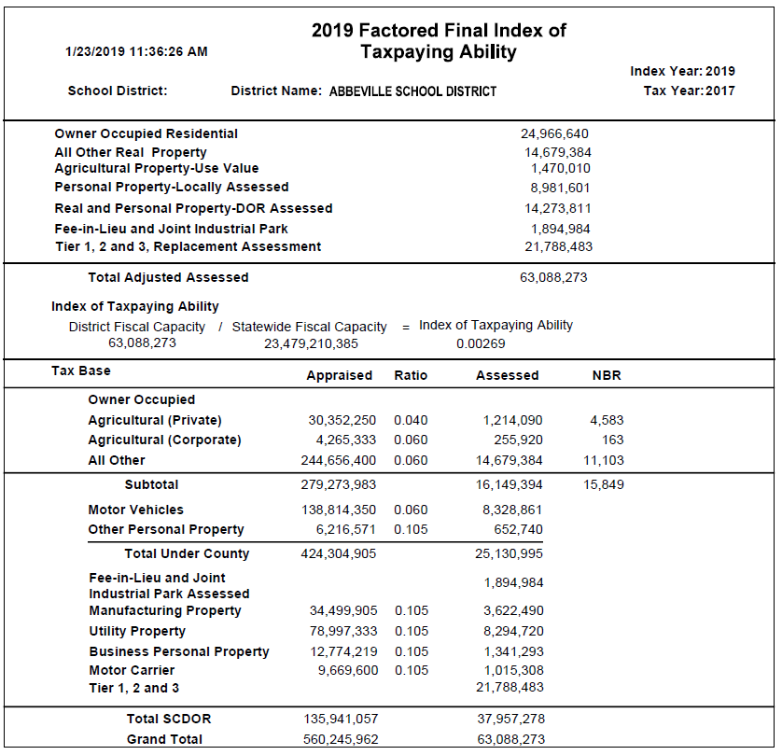

Slide 15
Example of Index Calculation
For Abbeville School District
District Fiscal Capacity 63,088,273
Statewide Fiscal Capacity 23,479,210,385
Index of Taxpaying Ability .00269
(63,088,273 / 23,479,210,385) = .00269

Slide 16
Calculating Total EFA Funding
Base Student Cost
X
Weighted Pupil Units
=
Total Funding

Slide 17
Calculating Total EFA Funding
Using Abbeville as Example
$2,489
X
3,979.35
=
$9,904,602

Slide 18
Calculating Base Student Cost
Local Amount
Base Student Cost
X
Statewide Weighted Pupil Units
X
.3 (Statewide Average)
X
Local Index of Taxpaying Ability
=
Local Required Support

Slide 19
Calculating Base Student Cost
Local Amount Using Abbeville Data
$2,489
X
991,411.02
X
.3
X
.00269
=
$1,991,371

Slide 20
EFA and Base Student Cost
Abbeville School District
Local Share $1,991,371
State Share $7,913,231
Total EFA $9,904,602
80% State Support

Slide 21
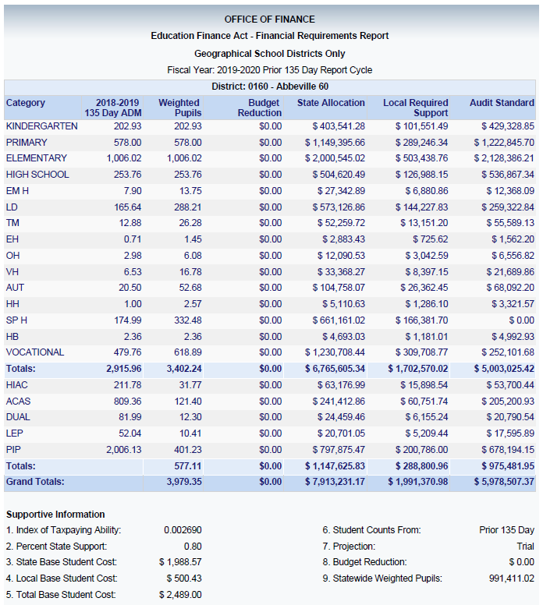

Slide 22
Historical General Fund Appropriations

Slide 23
Historical EIA Appropriations

Slide 24
Historical EIA Appropriations

Slide 25
What has changed over time????
Defined Minimum Program no longer exists
Employer Contribution no longer 100% State funded
Weighted Pupil Units changed by Proviso in FY 2014-15:
  All Students a 1.0
  New Personalized Learning Weights:
    Gifted and Talented 0.15
    Academic Assistance 0.15
    Limited English Proficiency 0.2
    Pupils in Poverty 0.2
    Dual Credit Enrollment 0.15

Slide 26
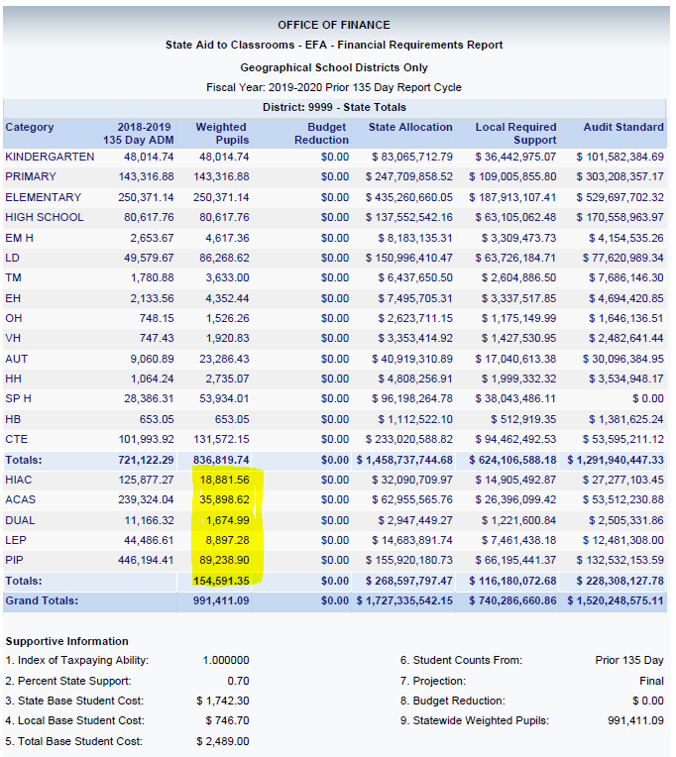

Slide 27
What has changed over time????
Assessment Ratio on Cars lowered from 10.5% to 6.0%
Index of Taxpaying Ability uses an imputed value for owner-occupied homes
District Flexibility
State Minimum Salary Schedule
Additional Programs and Incentives

Slide 28
Since 1983 …..
1984 - EIA enacted, increasing sales tax revenue from 4% to 5% with additional penny in a trust fund that is allocated annually
Key Component: Increasing average teacher salary to Southeastern average using a combination of EIA, EFA and Local funds and the Statewide minimum salary schedule
1996, 2002, 2006, 2012 – Charter school laws
1998, 2001 – Education Accountability Act (EAA) & No Child Left Behind – Move from equity to adequacy in funding
2005 – Education and Economic Development Act (EEDA) and Student Health & Fitness Act

Slide 29
Since 1983 …..
Continued
2006 – Act 388
2007 – SC Virtual School Program
2009 – District Flexiblity
2014 – Read to Succeed (summer reading camps, reading coaches, etc)

Slide 30
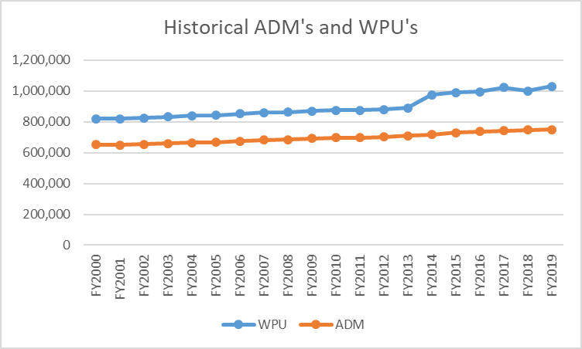

Slide 31
Thank you.
Questions?
Grant Gibson

